Slide 1


Employee Attrition Analysis
Jigyansha Dahal, Rojina Sapkota, Kreepa Adhikari, Pragya Uprety​

Slide 2
Introduction
Employee Attrition: when an employee leaves an organization for voluntary or involuntary reasons and is not replaced for a long time, or not ever.
17.3% attrition count in 2023 in the United States
Compensation : the key player
75% of the reasons for employee attrition can be prevented
The cost of losing an employee can range from tens of thousands of dollars to twice their annual salary

Slide 3
Problem Statement
Organizations struggle with high employee attrition rates that incur substantial costs and undermine performance, highlighting the need for research to understand attrition drivers and develop effective retention strategies.
Research
Objectives
Help businesses design tailored employee retention strategies
Identify the Predominant Causes of Employee Attrition

Slide 4

Methodology
Data Source & Description
IBM Employee Attrition Dataset
1470 records with 35 features
Data Wrangling (Python)
Checked for missing data
Set the column type to the desired type
Dropped irrelevant attributes
ML Models (Python)
Logistic Regression
XGBoost
KNN
Decision Tree
Random Forest
EDA and Inferential Analysis (Power BI)
Data Pre-processing (Python)
Encoded variables in binary codes
Checked for data inconsistency

Slide 5
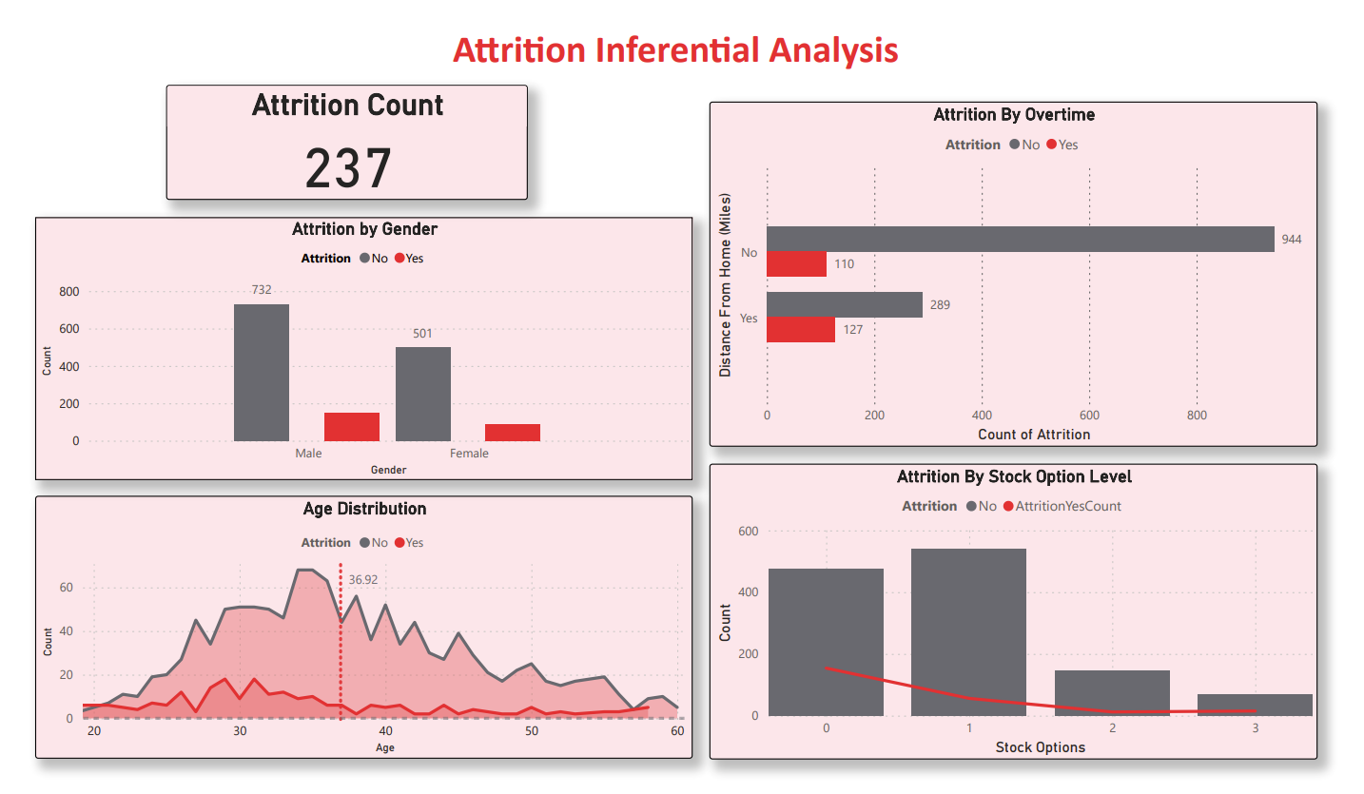

Slide 6
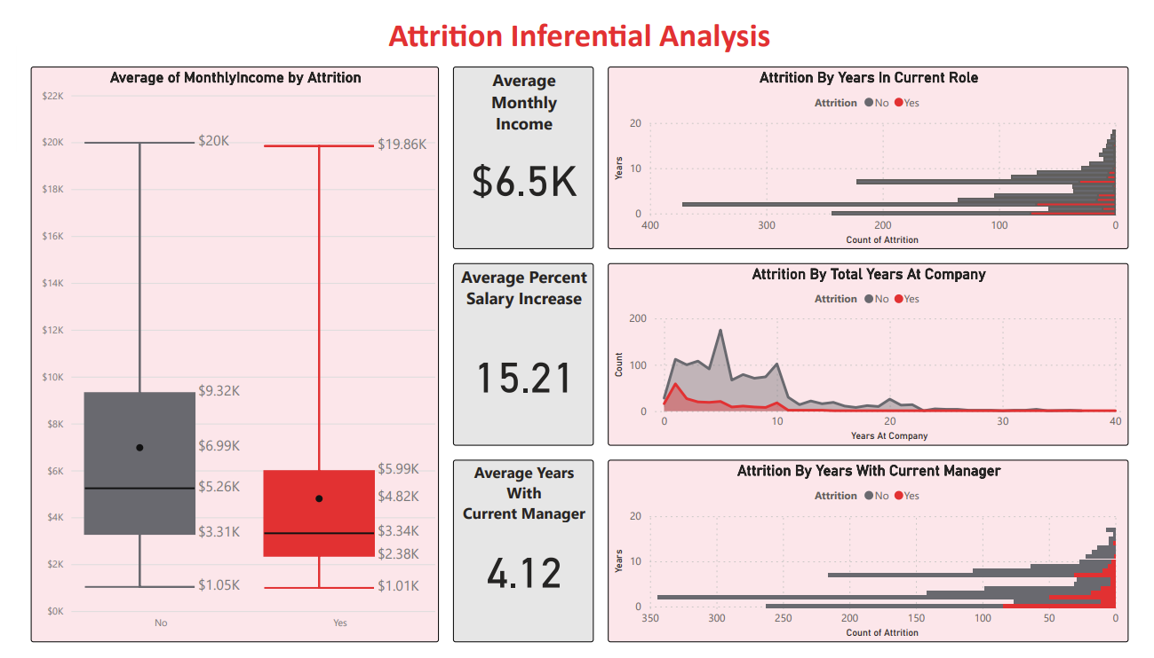

Slide 7
Model Comparison
Model | Accuracy | Specificity | Sensitivity | F1-Score
Logistic Regression | 86% | 98% | 35% | 0.49
XGBoost | 85% | 99% | 26% | 0.39
KNN | 83% | 100% | 9% | 0.17
Random Forest | 83% | 100% | 9% | 0.17
Decision Tree | 85% | 94% | 43% | 0.51
Based on these insights, Decision Tree seems to be the best model overall in this scenario because it has the highest F1-Score, indicating a better balance between precision and recall.
It also has the highest sensitivity, making it more reliable for identifying positive cases, which in this case is a case of attrition.

Slide 8
Results & Discussion
Employee attrition is more likely seen in employees with/who | Employee attrition is less likely seen in employees with/who
Live farther from work. | Older employees.
Higher percentage increase in their salary | Higher monthly income.
Worked in many companies before joining their current organization. | Have been a part of the workforce for a longer time.
Worked for the same company for many years. | Spent greater amounts of hours in training.
Low-medium environment satisfaction | Have been in the current role for many years.
Low-medium job involvement and satisfaction | Worked with the same manager for many years.
Less satisfied on the job | Travel in some capacity
Work overtime | Higher stock options level in the company.

Slide 9
Business Implication​
Holistic Compensation Approach
Frequent compensation benchmarking
Recognize long-serving employees
​Dynamic Job Evolution and Internal Mobility
Annual job description revision.
Promote growth with compensation benchmarking and support
Encourage lateral moves and cross functional assignments
Promote engagement and satisfaction in both job and environment.
​

Slide 10
Business Implication
Enhancing Retention Strategies
Recognize and value the expertise of older employees
Invest in collaborative technology and tools
Implement a rewards and recognition program
Foster a culture of appreciation

Slide 11
Limitations and Scope of Study
Clarify job level and stock options
Update pre-COVID dataset
Improve gender inclusivity and inclusion of individuals with disabilities
Expand dataset to encompass a wider range of roles
Exploring variable interdependence through multivariate analysis
Focus mainly on relatively higher-income individuals.

Slide 12
References
​
Briques, S. (n.d.). IBM Attrition.
https://sbriques.github.io/IBM-Attrition/
Tony Kwang Hyun Kim. (2020). IBM Attrition Dataset Analysis
https://rstudiopub-static.s3.amazonaws.com/712435_f134ef344f32490dbab2fdf610ce93b0.html
Apollo Technical. (n.d.). Statistics on employee retention. Retrieved from
https://www.apollotechnical.com/employee-retention-statistics/#:~:text=Statistics%20on%20employee%20retention,looking%20at%20only%20high-performers

Slide 13
THANK YOU!

